Slide 1
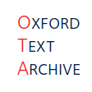

Linguistic Annotation in the TEI
LRBS 2025
Digital Editing

Slide 2
What is linguistic annotation?
According to TEI guidelines 16.4: Annotation determined by an analysis of the linguistic features of the text.
Syntactic analysis – analysis of sentence and clause structure.
Lexical analysis – word-level analysis of syntax and semantics; lemmatization and normalization are applied at this level.
Annotation at word-level is often referred to as ‘tagging’.
Morphological analysis – identification of morphemes within a word.

Slide 3
Why would you use linguistic annotation?
Used largely for linguistic corpora.
Corpus linguistics – the study of language in a written context.
Implementation dependent on corpus design.
Useful for enhancing search functionality in digital editions and increasing the usability of your text.
Search by lemma.
Search by POS.
Search by semantic field.
Downsides of linguistic annotation
Reduced readability.
Not a ‘plain text’.

Slide 4
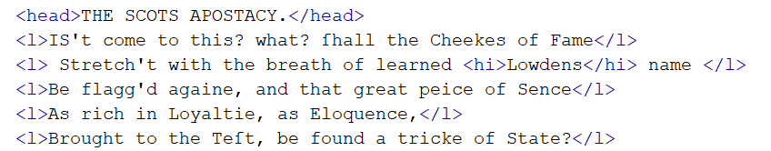
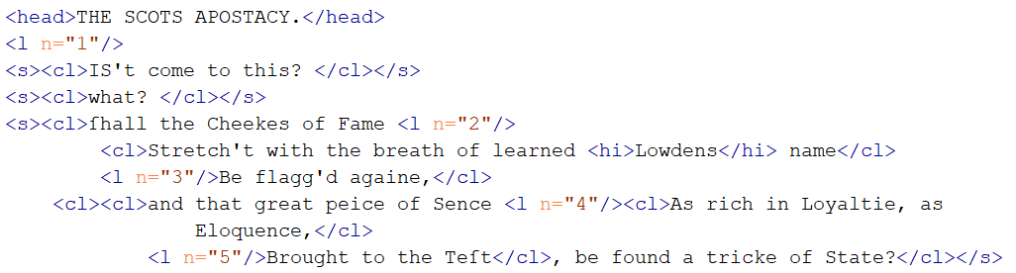
What does it look like?
Basic example
Syntactic analysis
See TEI Guidelines 18.1

Slide 5
Summary
<s> for sentences
<cl> for clauses
@type to describe the type of clause.
Milestone markers = empty elements that indicate the presence of a feature in the text = <l/>

Slide 6
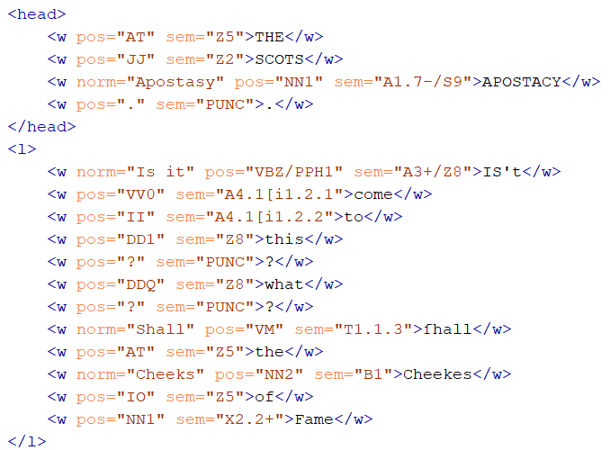
What does it look like?
Lexical analysis
See TEI Guidelines 16.4
Basic example

Slide 7
Summary
<w> for words
@pos for part of speech
@sem for semantic category
@norm for normalized form
@orig for original form
@lemma for lemma
CLAWS7 Tagset – https://ucrel.lancs.ac.uk/claws7tags.html
USAS Tagset – https://ucrel.lancs.ac.uk/usas/USASSemanticTagset.pdf

Slide 8
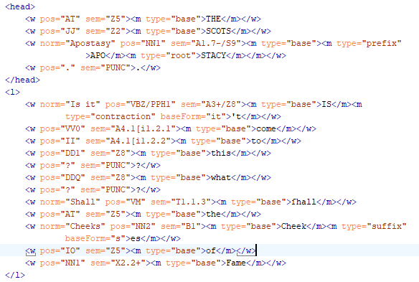
What does it look like?
Morphological Analysis
See TEI Guidelines 18.1.2
Basic example

Slide 9
Summary
<m> for morphemes (can be contained by <w>)
@type – base, prefix, root, suffix.

Slide 10

Tools for implementing linguistic annotation
USAS tagger (for part-of-speech and semantic tagging) – can be implemented through Wmatrix and LancsBox.
VARD (for normalization).
NLTK (Natural Language Toolkit) (for lemmatization).

Slide 11
Demo of the USAS tagger

